Slide 1
Practical Exam - Recipe Site Traffic
Mohamed Sayed
DataCamp Data science Professional Certification

Slide 2
Overview
Tasty Bites is a search Engine for recipes helping people to find ways to use their home supplies for easy meals
The business wants to use Data Science to improve their traffic on the website.
During the project, exploratory Data analysis, visualization and Machine learning techniques will be used to have insights and increase the traffic.
We also will implement a Key performance indicator for easy evaluation of our models and for further usage.

Slide 3
Business goals
The company noticed that the traffic of the website increases according to the recipes that are shown on the homepage of the website.
Choosing the recipes is a critical process that affect the traffic directly, so modification in the process could increase the traffic dramatically.
The business goals are to :
Predict which recipes will lead to High Traffic.
Predict High Traffic recipes correctly 80% of the time.

Slide 4
Summary
To address the problem, I first had to explore the data and get insights from it before using Machine Learning techniques.
Data was cleaned and organized to be used for further analysis.
Exploratory data analysis were made to see insights, relationships between different features, and effect of feature on traffic.
Visualization were made to see the distribution of the data, their relationships, and locate outliers.
Later, the problem were indicated as classification, then 2 machine learning models were fitted and used to predict the outcome.
A key Performance indicator were defined to help assess the model and compare results in more understandable way.

Slide 5
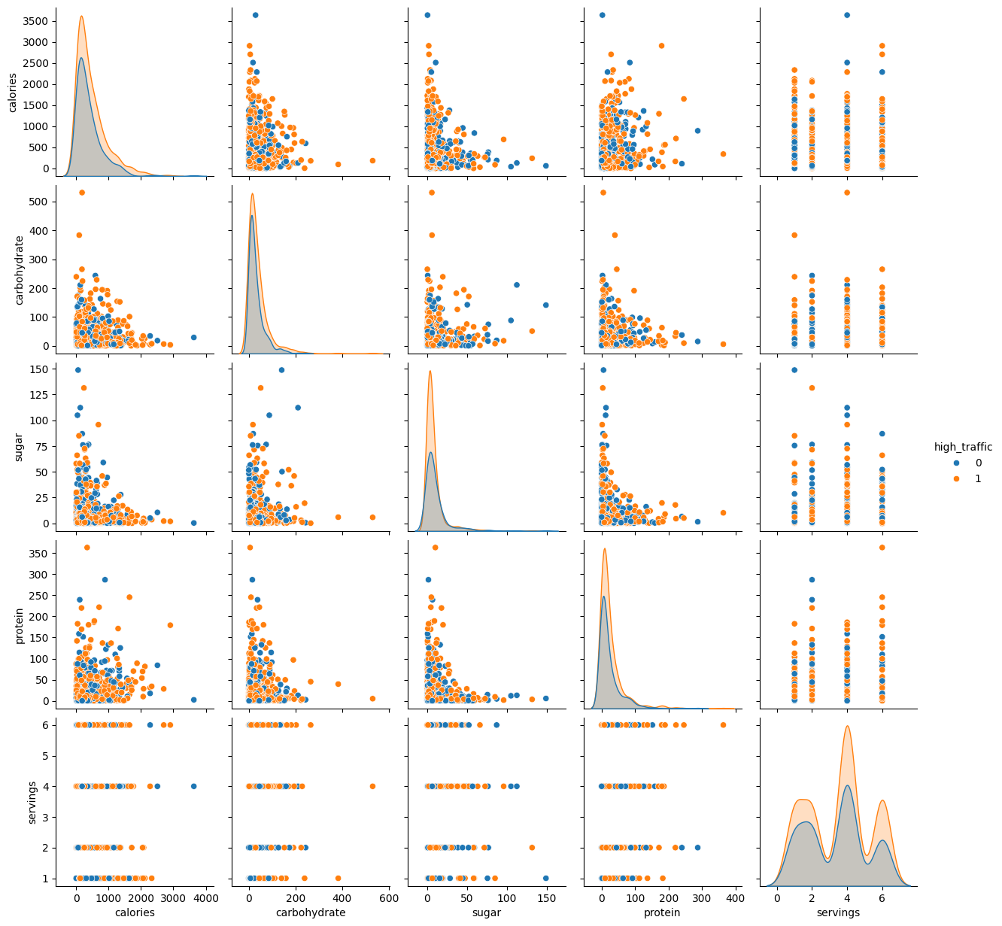
Outcome Exploratory Analysis: visualization of the data were made to explore the distribution.
The pair plot showed that there is no correlation between numerical features.
It also showed that the distribution of the data is skewed to the right, which need normalization should be made to use data.

Slide 6
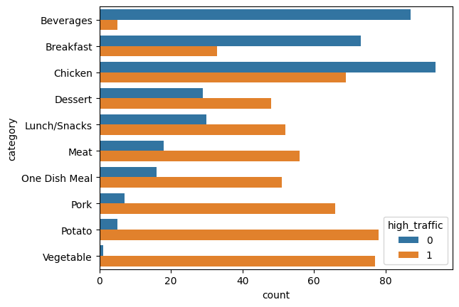
Outcome Effect of recipe category on traffic
The following graph represents the percent of each category against the traffic.
The graph shows that category highly affect the traffic.
It shows that recipes with Vegetable, Pork, and potato has high traffic.
While beverages and breakfast has low traffic.
So, Recipes with high traffic categories should be highlighted.

Slide 7
Outcome Machine learning models
Baseline: Logistic Regression
Random Forest Classifier
Logistic regression were used as a baseline Model.
On training, it showed good accuracy with 76.25%, and it correctly predicated High traffic (precision) 80% of the time, which align with business requirement.
While tested, the percentages almost didn’t change, which means the model could be used for increasing traffic.
On comparing RF against Log Reg, it scored higher accuracy and precision.
On training, it showed 86 accuracy and precision 83.6 precision, which also aligns with business requirement.
When tests, the accuracy dropped to 77%, but maintained precision 80%, which means it will be safe to use it to predict high traffic correctly.

Slide 8
Business metric Key performance indicator (KPI)
In order to compare results, a new parameter were defined to make easier and more obvious comparisons.
We defined our KPI as the ratio of Correctly High Traffic predications to mistakenly predicted High traffic recipes.
Our goal is 80%, to achieve our goal, we need to have Ration higher than 4.
For our models, Logistic Regression(LogReg) achieved 4 for training, and 4.22 for testing, while Random forest(RF) achieved 5.13 for training and 4 for testing.
The results showed that Both LogReg and RF could be used to predict the high traffic recipes to be shown on the home page, which will increase website traffic.

Slide 9
Recommendations.
To help the website increase the traffic, we can implement Random Forest Classifier to predict if the recipe will get High traffic or not to be displayed in the homepage. By implementing the Model, we will be able to predict more Than 80% of High traffic recipes. This will help choosing the right recipes and therefore increasing the traffic.
To implement and Improve model, I may consider the following:
Collecting more data, as grouping categories that visitors choose, and timestamp of visits of each category
Looking for best way to implement the model in terms of performance and cost. In my PoV, best way that the model implemented directly to the website and update by itself based on the visits, but that may need some work. Simpler way is to change the recipes every day manually based on Visits and prediction of new recipes.

